Slide 1
Hands on Training AI with Python
In collaboration with:
Women University Swabi
Abasyn University Peshawar

Slide 2
Course Outline
Artificial Intelligence introduction
Python Fundamentals
Python Libraries
Machine Learning

Slide 3
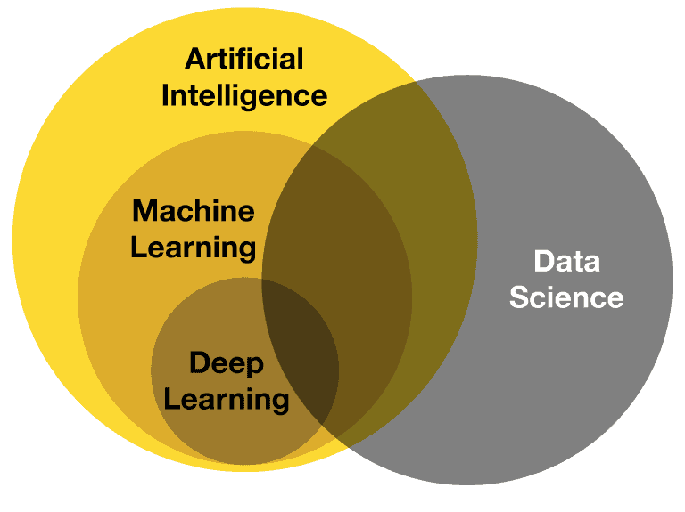

Slide 4
Artificial Intelligence
Machine Learning
Deep Learning
Data Science
Max 2 lectures of 40 minutes

Slide 5
Python Fundamentals
Why Python?
Environment
Programming with Numbers and Strings
Python Data Structures
Conditional Statements
Loops
Functions
Files Handling
Objects and Classes
Max 8/9 lectures of 40 minutes

Slide 6
Python Libraries
Numpy
Pandas
2 + 3 lectures of 40 minutes

Slide 7
Machine Learning
Naive Bayes
Linear Regression
Logistic Regression
Support Vector Machines
k-Nearest Neighbours (Types)
Decision Trees (Types/Ensemble Methods)
1 lecture for each of 40 minutes

Slide 8
Discussion/ Q&A

